Slide 1



.
BIG
DATA
Big Data PPT
What is Big Data
.
.
Ajit Kushwaha

Slide 2
Big Data is characterized by large volumes
Of different type of data( e.g. Social, web, application, transaction etc.) that build very
quickly.
It exceed the reach of commonly used hardware environments and software tools to capture, manage and the process in a timely for its users.
Big Data

Slide 3
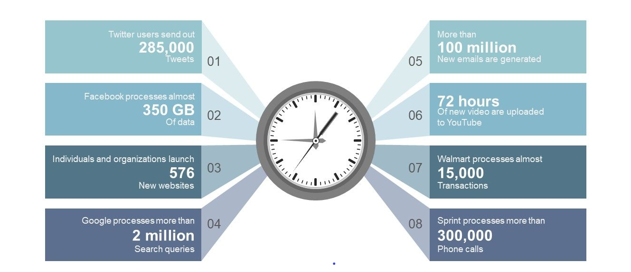
Bid Data Facts- How Big is Big Data

Slide 4
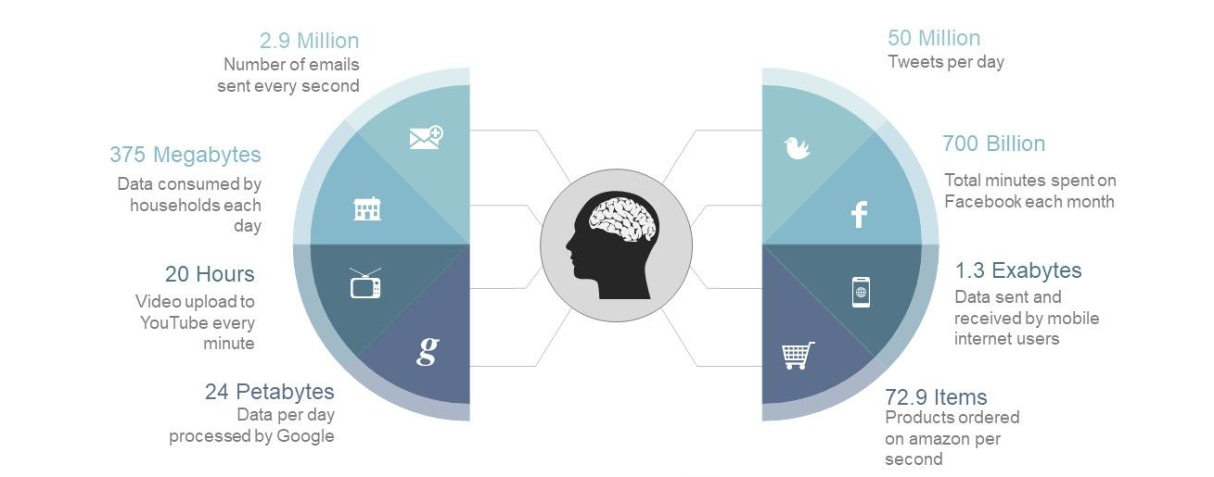
Bid Data Facts- How Big is Big Data

Slide 5
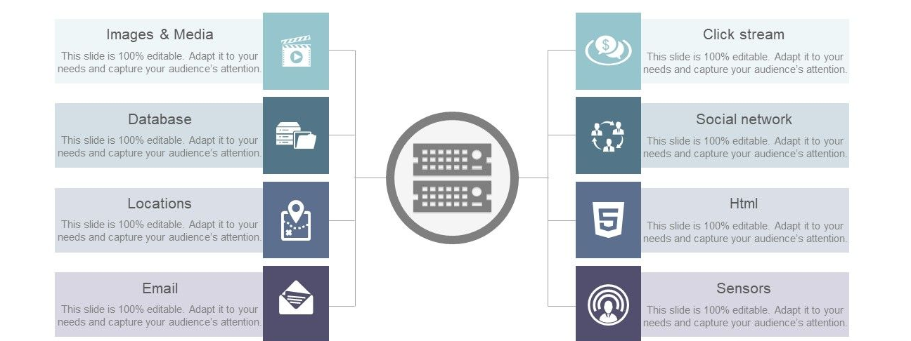
Sources of Big Data

Slide 6
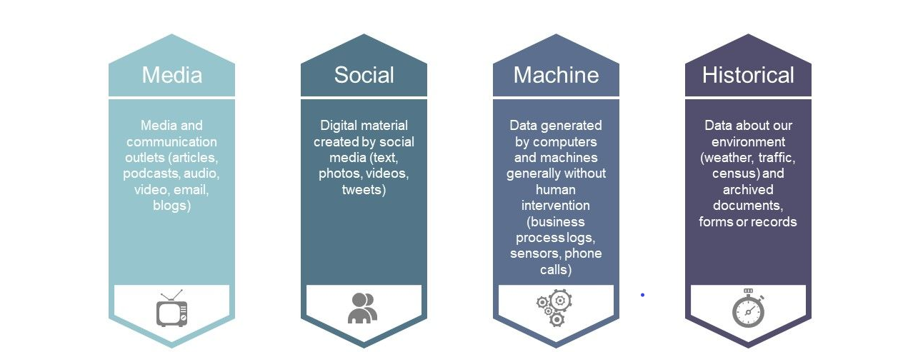
Sources of Big Data

Slide 7
5 V’s of Big Data
VOLUME
Terabyte
Record/Arch
Tables/Files
Distributed
Huge Amount of Data
Different formats of Data from various resource
VARIETY
Structured
Unstructured
Linked
Dynamic
VELOCITY
Batch
Real/near-time
Process
Stream
5 V’s
Of
Big Data
High speed of Accumulation of Data
VERACITY
Trustworthiness
Authenticity
Origin/reputation
Availability
VALUE
Statistical
Events
Correlation
Hypothetical
Extract useful Data
Inconsistence and uncertainty in Data

Slide 8
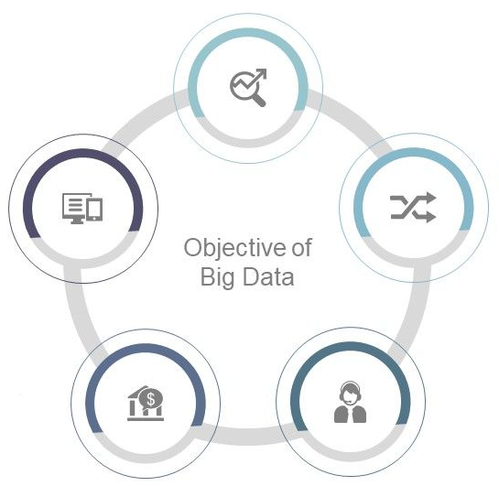
Objective of Big Data
Analyzing customer
behavior
Be more responsive to the market
Combining multiple data source
Generate additional revenue
Improving Costumer Service

Slide 9
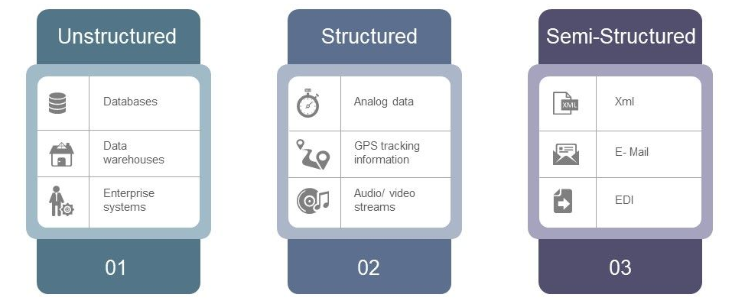
Types/Forms of Big Data
Any data that can be stored, accessed and processed in the form of fixed format is termed as a ‘structured’ data.
Any data with unknown form or the structure is classified as unstructured data.
Semi-structured data can contain both the forms
of data.

Slide 10
THANK YOU

